Slide 1
3. Programs and Algorithms

Slide 2
Programs and Algorithms
The Vehicle for the computer Solution in a problem is a set of explicit and unambiguous instructions expressed in a programming language.
This set of instructions is called a Program.
A Program may also be thought of as an algorithm expressed in a programming language
An Algorithm therefore corresponds to a solution to a problem that is independent of any programming language.

Slide 3
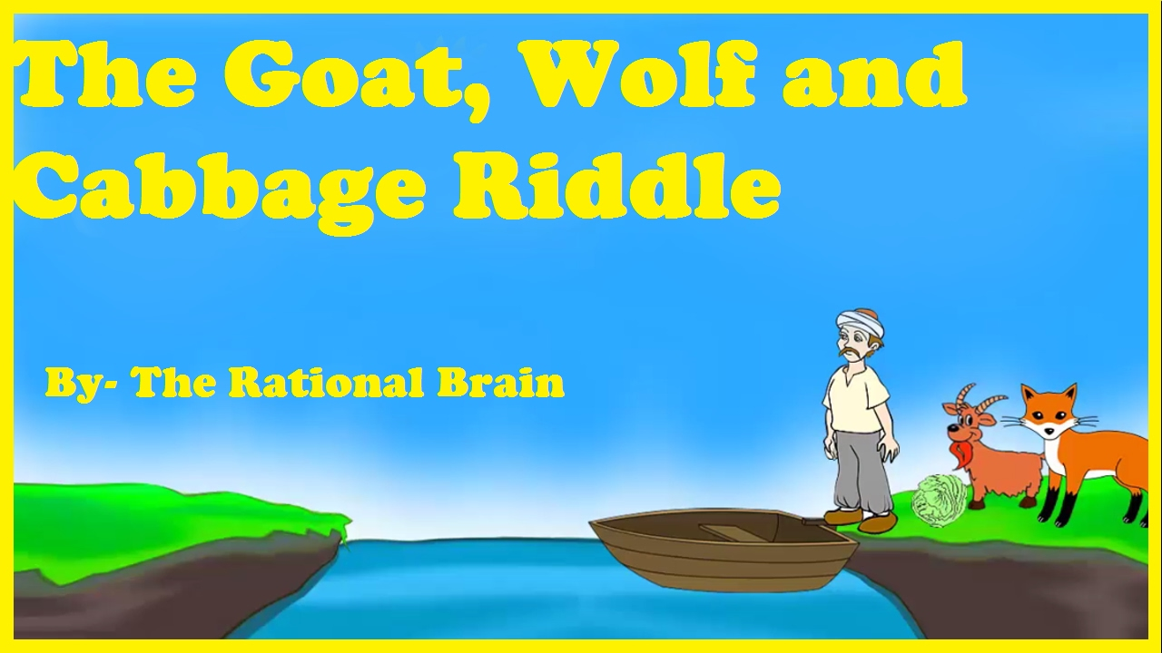

Slide 4
Problem 1
A farmer wants to cross a river and take with him a wolf, a goat, and a cabbage.
There is a boat that can fit himself plus either the wolf, the goat, or the cabbage.
If the wolf and the goat are alone on one shore, the wolf will eat the goat.
If the goat and the cabbage are alone on the shore, the goat will eat the cabbage.
How can the farmer bring the wolf, the goat, and the cabbage across the river?
https://www.youtube.com/watch?v=WAWAQQuyWCc

Slide 5
Solution – 1
Step 1: Farmer takes Goat across the river (leaving Wolf and Cabbage behind)
Step 2: Farmer returns alone
Step 3: Farmer takes Wolf across the river
Step 4: Farmer returns with Goat
Step 5: Farmer takes Cabbage across the river
Step 6: Farmer returns alone
Step 7: Farmer takes Goat across the river

Slide 6
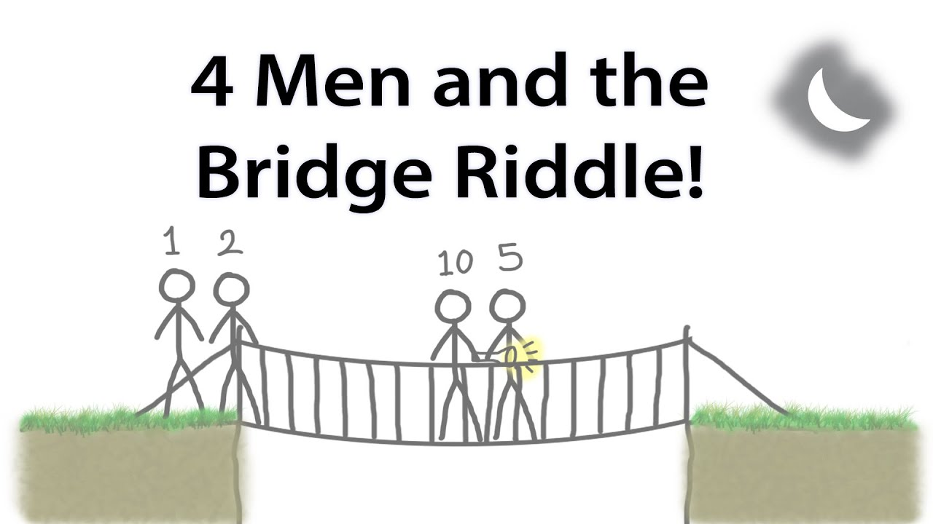
https://www.youtube.com/watch?v=7yDmGnA8Hw0&list=PLJicmE8fK0EiFRt1Hm5a_7SJFaikIFW30&index=2

Slide 7
Problem - 2
There are 4 men who want to cross a bridge. They all begin on the same side. You have 17 minutes to get all of them across to the other side. It is night. There is one flashlight. A maximum of two people can cross at one time.
Any party who crosses, either 1 or 2 people, must have the flashlight with them. The flashlight must be walked back and forth, it cannot be thrown etc.
Each man walks at a different speed. A pair must walk together at a rate of the slower man's pace.
Man 1: 1 minute to cross, Man 2: 2 minutes to cross., Man 3: 5 minutes to cross., Man 4: 10 minutes to cross.
For example, if Man 1 and Man 4 walk across first, 10 minutes have elapsed when they get to the other side of the bridge. If Man 4 returns with the flashlight, a total of 20 minutes have passed, and you have failed the mission.
https://www.youtube.com/watch?v=PQ4PxIO-aq0

Slide 8
Solution - 2
Step 1: Men 1 and 2 travel over - Time Elapsed 15
Step 2: Man 2 brings back the flashlight – Time Elapsed 13
Step 3: Men 3 and 4 travel over and – Time Elapsed 3
Step 4: Man 1 brings back the flashlight – Time Elapsed 2
Step 5: Men 1 and 2 travel over – Time Elapsed 0

Slide 9
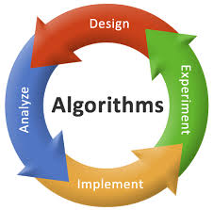
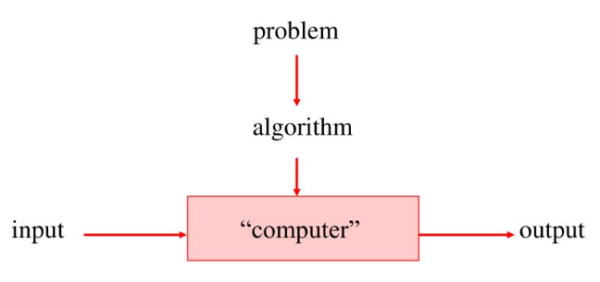

Slide 10
5. Algorithms

Slide 11
Algorithm – Introduction
An algorithm describes the step by step action to solve a problem.
An algorithm has a well defined sequence of steps, it gives you an output, and it will eventually terminate.
An algorithm is a self-contained step-by-step set of operations to be performed to solve a specific problem or a class of problems.
It finds a relationship between Input and Output.
Algorithm is for Computational Problem.
Algorithm is independent of programming language
Father of Algorithm : 9th-century mathematician Muḥammad ibn Mūsā al-Khwārizmī

Slide 12
Properties of an Algorithm
Finiteness. An algorithm must always terminate after a finite number of steps.
Definiteness. Each step of an algorithm must be precisely defined; the actions to be carried out must be rigorously and unambiguously specified for each case.
Input. An algorithm has zero or more inputs, i.e, quantities which are given to it initially before the algorithm begins.
Output. An algorithm has one or more outputs i.e, quantities which have a specified relation to the inputs.
Effectiveness. An algorithm is also generally expected to be effective. This means that all of the operations to be performed in the algorithm must be sufficiently basic that they can in principle be done exactly and in a finite length of time.

Slide 13
Complexity of Algorithm
1. Time Complexity: Running time of the program as a function of the size of input
2. Space Complexity: Amount of computer memory required during the program execution, as a function of the input size.

Slide 14
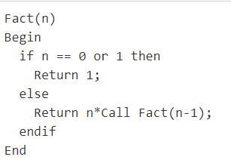
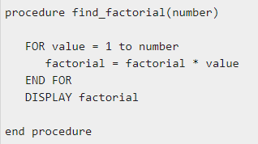
Components and Flow of an Algorithm
Components : Input, Output, Set of Operations(Process).
Flows: Sequence, Branching, Looping and Recursion.

Slide 15
Activity: Search, Find & Present
Search online to find any one algorithm to showcase the following.
Sequencing
Branching
Looping
Recursion

Slide 16
Algorithm Vs. Pseudo Code Vs. Flowchart Vs. Program
Algorithm
Set of step-by-step instructions that perform a specific task or operation
Natural language, NOT programming language
Pseudocode
Set of instructions that mimic programming language instructions
Flowchart
Visual program design tool
Semantic symbols describe operations to be performed
Program
Implementation of Algorithm in Programming Language

Slide 17
Example : Algorithm – Linear Search
Start from the leftmost element of arr[] and one by one compare x with each
element of arr[].
2. If x matches with an element, return the index.
3. If x doesn’t match with any of elements, return -1.

Slide 18
Example : Pseudo Code – Linear Search
FUNCTION linearSearch(list, searchTerm):
FOR index FROM 0 -> length(list):
IF list[index] == searchTerm THEN
RETURN index
ENDIF
ENDLOOP
RETURN -1
END FUNCTION

Slide 19
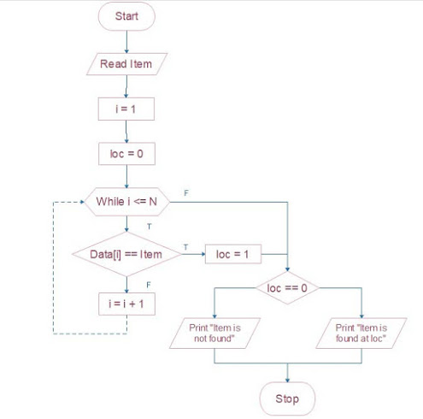
Example : Flowchart– Linear Search

Slide 20
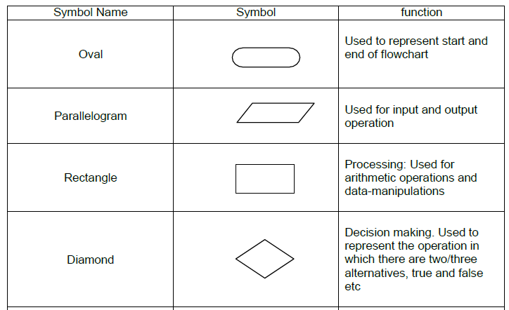
Flowchart Symbols

Slide 21
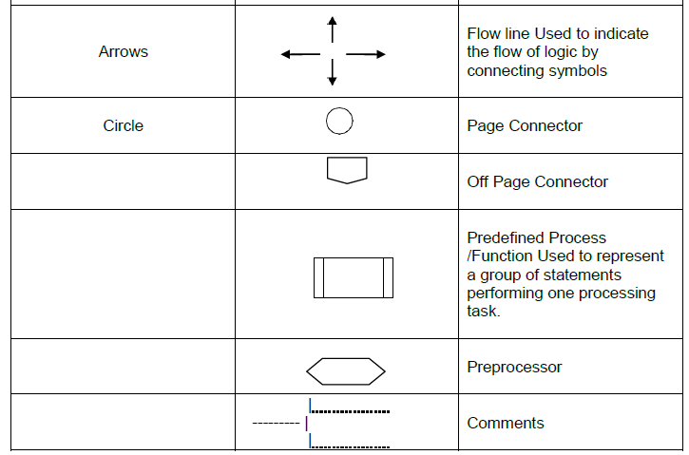

Slide 22
Complexity Analysis of Linear Search
Array Size : n
Parameter for evaluation: Number of Comparison
Best Case: If element to be searched is always first element of an array. O(1)
Worst Case: If element to be searched is always last element of an array or not present. O(n)

Slide 23
6. Flowcharts

Slide 24

The Flowchart
(Dictionary) A schematic representation of a sequence of operations, as in a manufacturing process or computer program.
(Technical) A graphical representation of the sequence of operations in an information system or program.
Information system flowcharts show how data flows from source documents through the computer to final distribution to users.
Program flowcharts show the sequence of instructions in a single program or subroutine. Different symbols are used to draw each type of flowchart.

Slide 25
The Flowchart
Flowchart Symbols
Flowchart
shows logic of an algorithm
emphasizes individual steps and their interconnections
e.g. control flow from one action to the next

Slide 26
The Flowchart: Example
START
Input
M1,M2,M3,M4
Step 1: Input M1,M2,M3,M4
Step 2: GRADE ← (M1+M2+M3+M4)/4
Step 3: if (GRADE <50) then
Print “FAIL”
else
Print “PASS”
endif
GRADE←(M1+M2+M3+M4)/4
IS
GRADE<50
N
Y
PRINT
“PASS”
PRINT
“FAIL”
STOP

Slide 27
The Flowchart: Example
START
Write an algorithm and draw a flowchart that will read the two sides of a rectangle and calculate its area.
Pseudo code
Input the width (W) and Length (L) of a rectangle
Calculate the area (A) by multiplying L with W
Print A
Input
W, L
A ← L x W
Print
A
STOP

Slide 28
The Flowchart
Flowcharts is a graph used to depict or show a step by step solution using symbols which represent a task.
The symbols used consist of geometrical shapes that are connected by flow lines.
It is an alternative to pseudo coding; whereas a pseudocode description is verbal, a flowchart is graphical in nature

Slide 29
The Flowchart Rules
sequence control structure
selection control structure
Statement 1
No
Yes
Condition
Statement 2
else-
statement(s)
then-
statement(s)
Statement 3
:

Slide 30
The Flowchart Rules
repetition control structure
yes
Loop
Statement(s)
Condition
no

Slide 31
7. Algorithms and Flowcharts – Samples

Slide 32
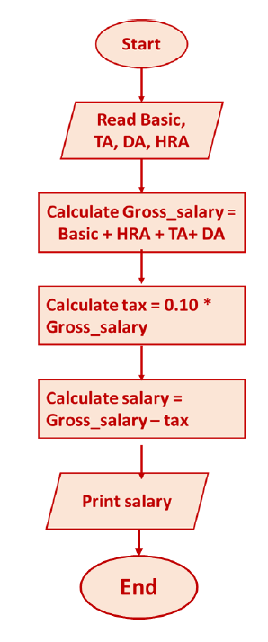
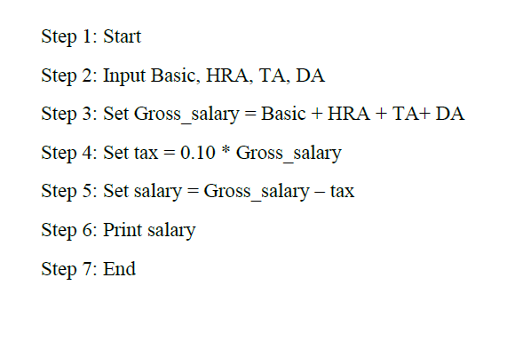

Slide 33
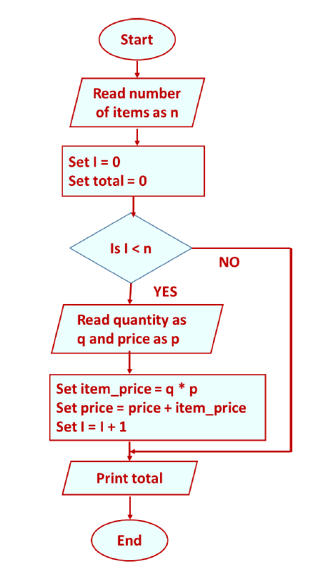
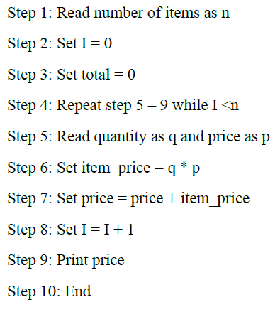

Slide 34
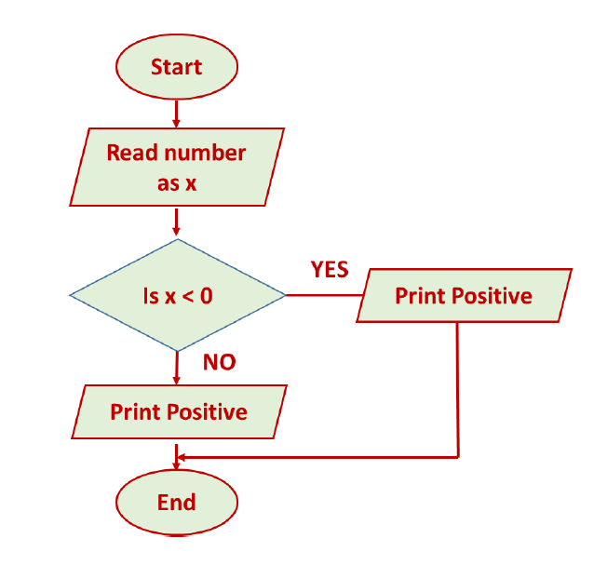
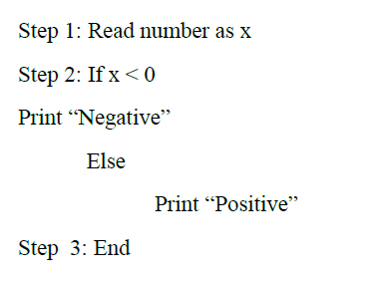

Slide 35
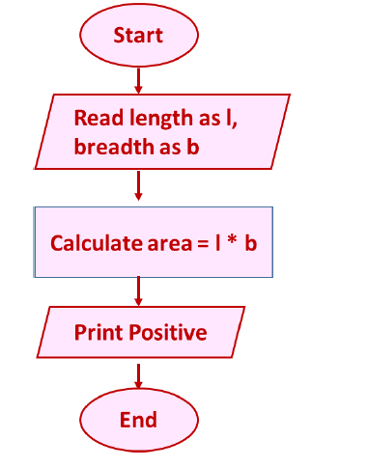
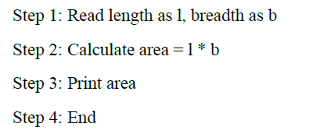

Slide 36
